Slide 1
4 Stages of Product Maturity Cycle
The first stage is the introduction stage.
The next stage is the growth stage.
The penultimate stage is the maturity stage.
The final stage is the decline stage
Notes:
There are 4 stages to a product maturity cycle; Introduction stage, growth stage, maturity stage and the decline stage.

Slide 2
The Introduction Stage
This is the stage when the product has just been introduced into the market and has a low interest level to the consumer so the demand will be lower but will steadily increase over time.
This is represented on a graph by the slowly increasing gradient.
Notes:
The introduction stage is where the product is introduced into the market, meaning the demand is low.

Slide 3
The Growth Stage
This is the stage where interest in the product is increasing and therefore the demand for the product also increases.
This is represented on the graph by the larger increase of gradient indicating that the demand for the product is increasing.
Notes:
The growth stage is where the products demand begins to grow at a larger rate than during the intro stage.

Slide 4
The Maturity Stage
This is the part of the cycle where the demand for the product peaks and then slowly begins to decline as the product has fallen out of fashion and demand for it begins to ceases.
This is shown by the graph reaching its peak point then beginning to decreases with a negative gradient.
Notes:
The maturity stage is where the demand peaks and then begins to decline showing that the interest and demand in the product is being lost.

Slide 5
The Decline Stage
This stage is where the interest and demand for the product decline rapidly and the death of the product occurs where production is ceased to prevent further profit losses.
This is show by the negative gradient and the death by the end of the graph mid way into a section.
Notes:
The decline stage is where the product ‘dies’ and ceases to be promoted and created.

Slide 6
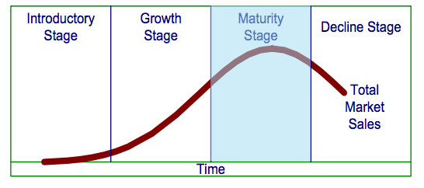
The Graph
Notes:
All the stages are shown in the graph. The introduction stage by the slowly increasing gradient. The growth stage by the quickly increasing gradient. The maturity stage by the increasing gradient, peak, then decreasing gradient. Then the decline stage shown by the negative gradient.

